Slide 1

An Exploration of Mental Health in the Tech Industry
Presented by:
Bryan Alcazar
Jenie Nam
Quaid Scrivens
QinQin Zha
January 23th, 2020
UCI Bootcamp Project

Slide 2
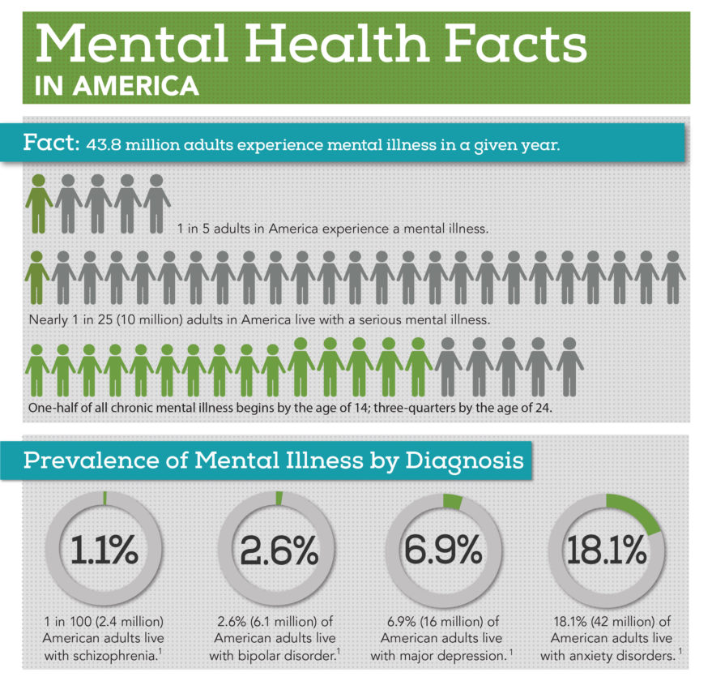
Mental Health issues are common in the United States
10 million adults in American live with a serious mental illness, according to the National Alliance on Mental Illness.

Slide 3
Questions:
Has the perception of mental health changed in the workplace?
How does the perception of mental health compare to that of physical health in the workplace?
Has the awareness of mental health changed over time?

Slide 4
Project flow chart
Team discussion about the interested topic and source dataset
Each team member focus on different year’s csv to clean up the data based on the specific survey questions asked
Data plot based on the cleaned dataset
Data analysis, discussion and draw conclusion
Notes:
cleaning

Slide 5
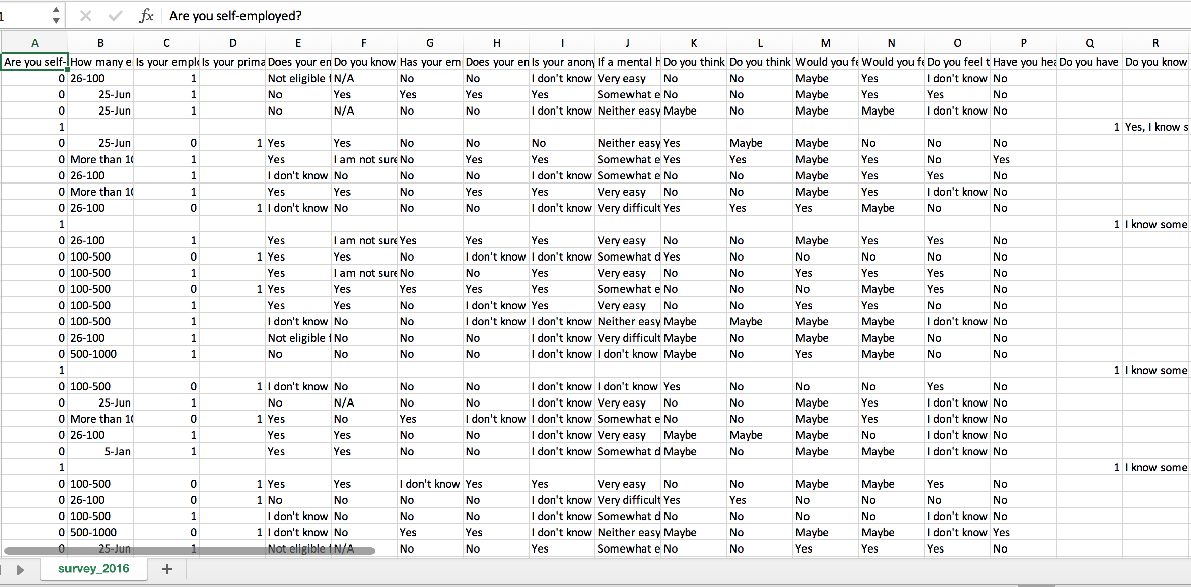
Introduction to the Data:
The Survey csv from Kaggle

Slide 6
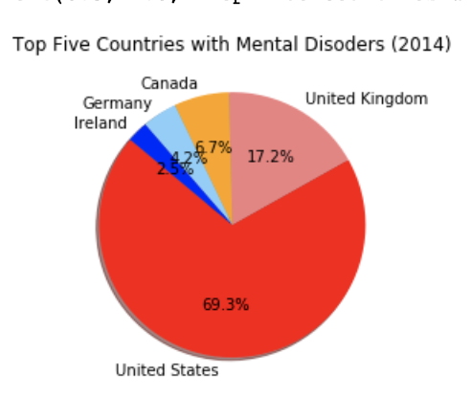
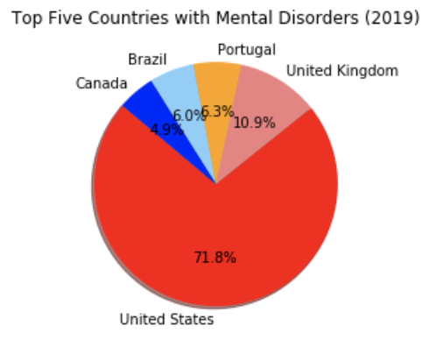
Top Five Countries by Number of Responses
Notes:
cleaning

Slide 7
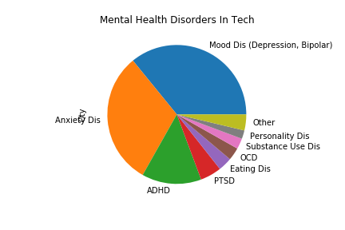
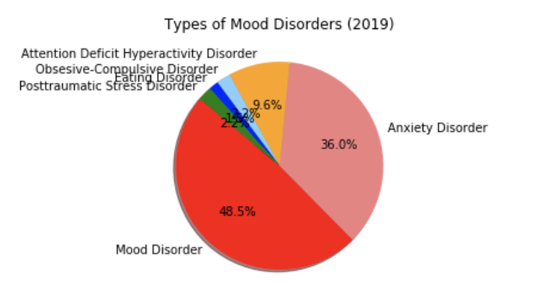
Common Types of Mental Illnesses
Notes:
cleaning

Slide 8
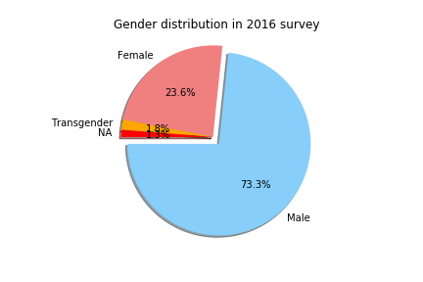
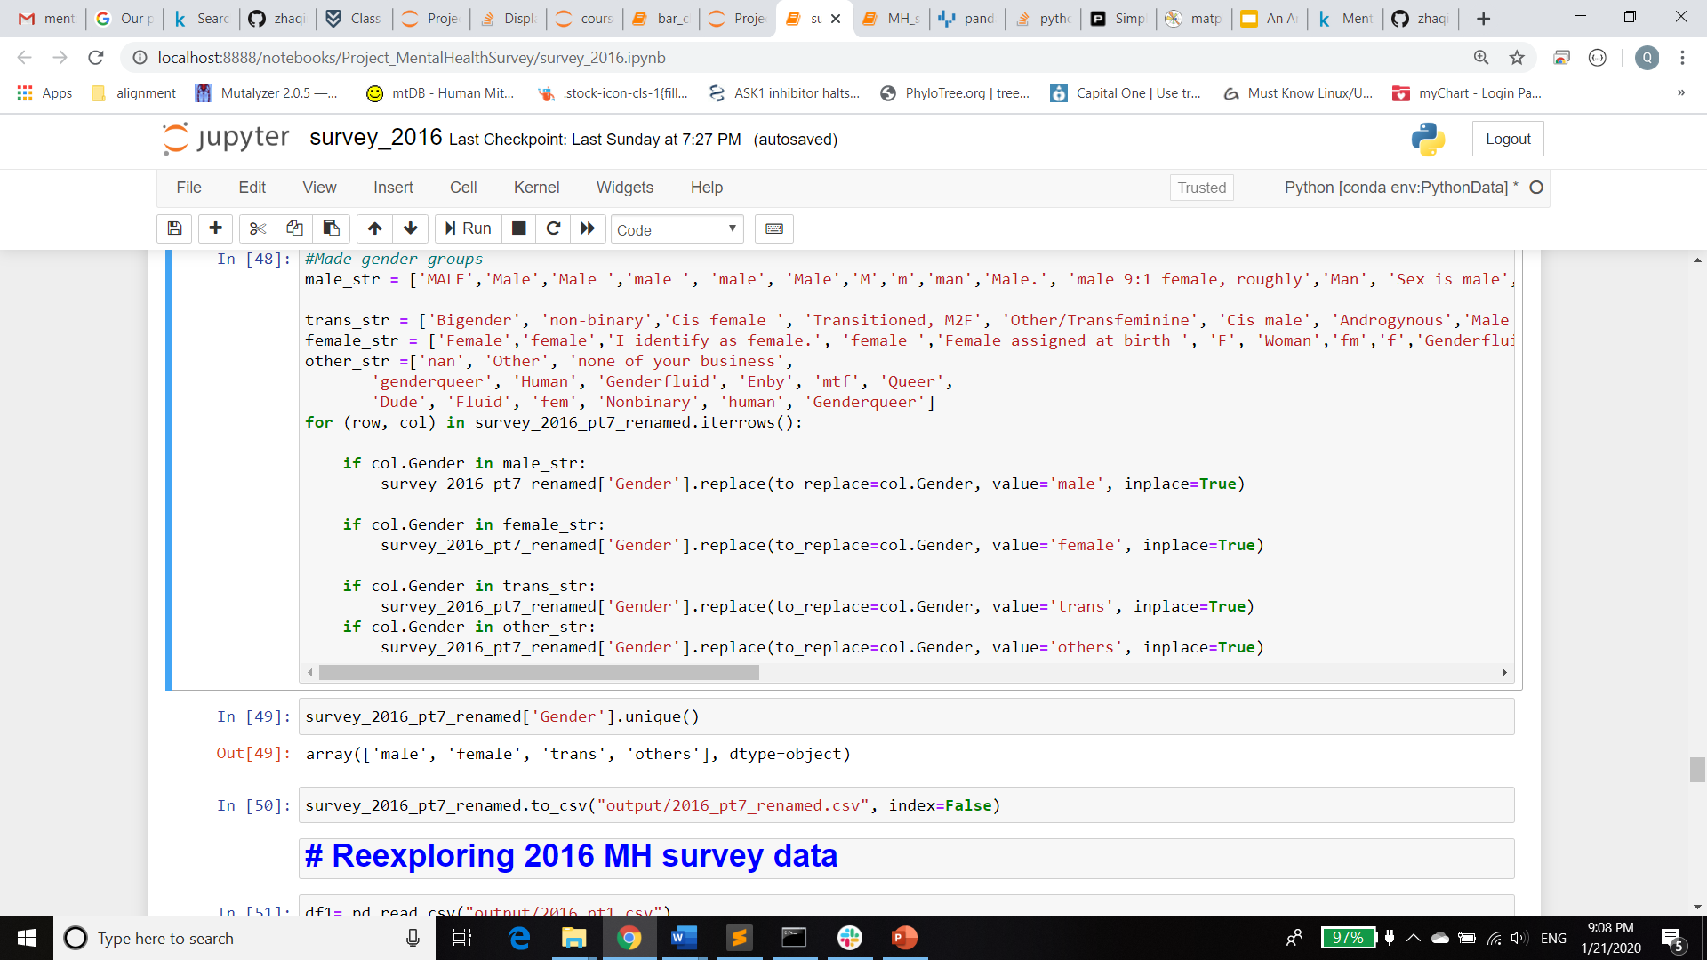
Gender Counts

Slide 9
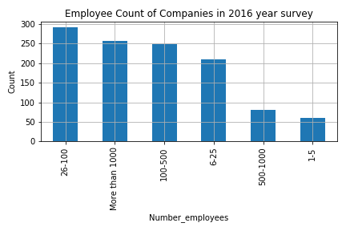
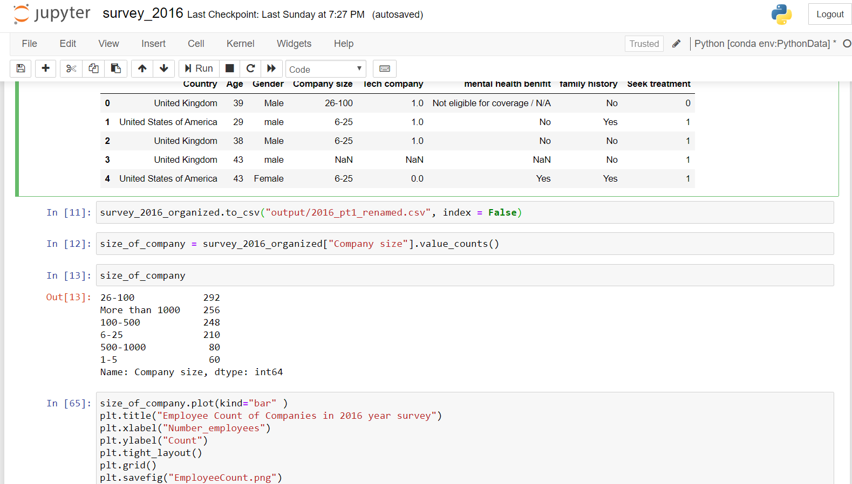
Employee size of the companies

Slide 10
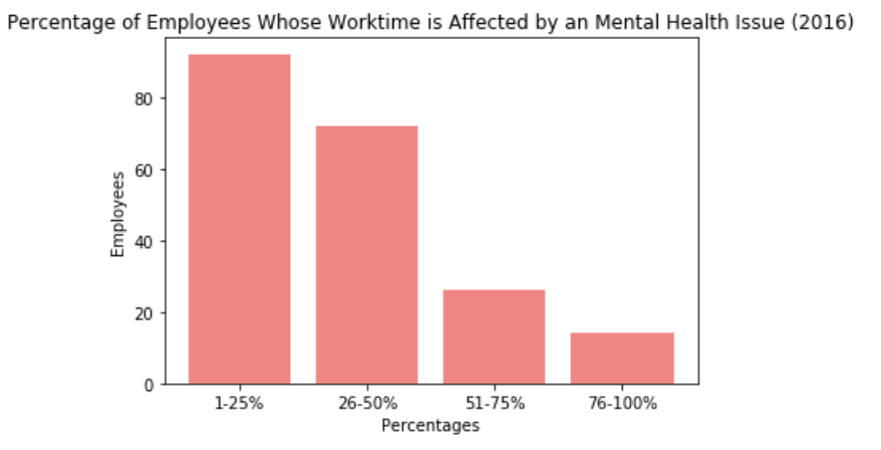
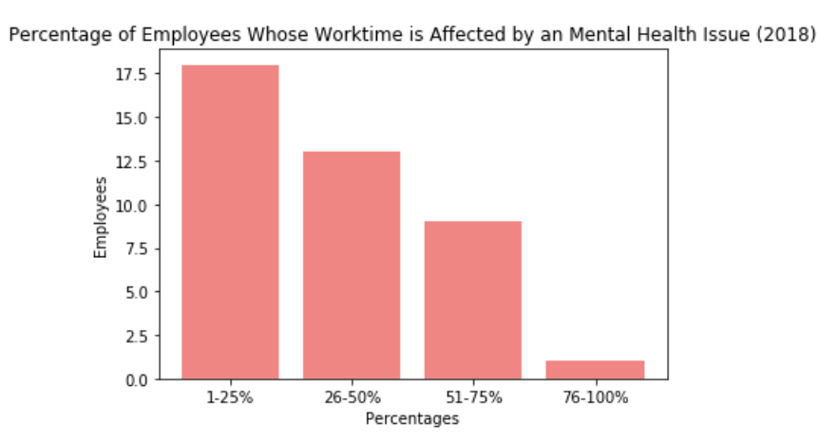
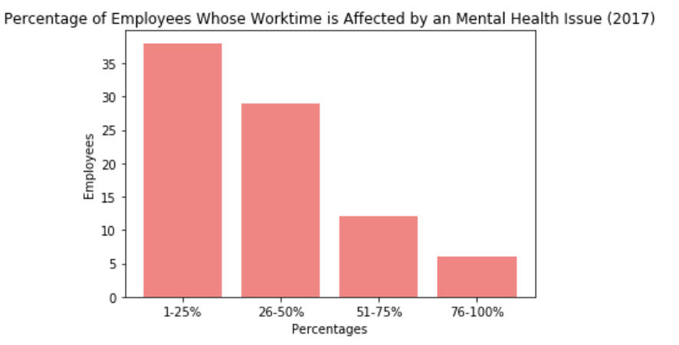
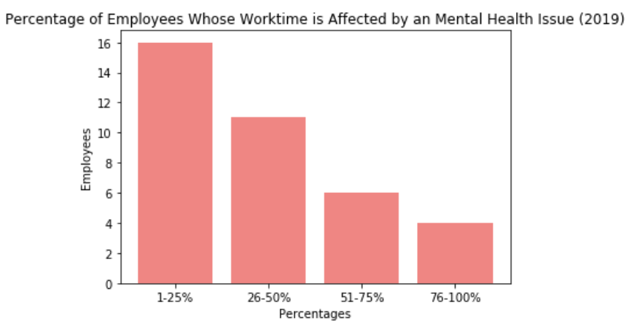
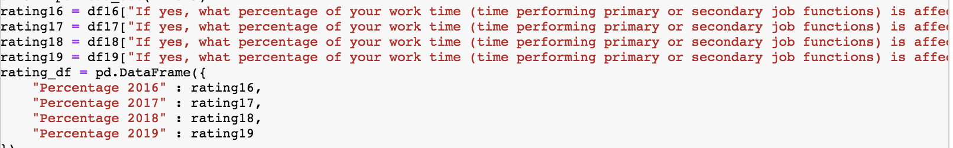
The Effect of Mental Disorders on Work

Slide 11
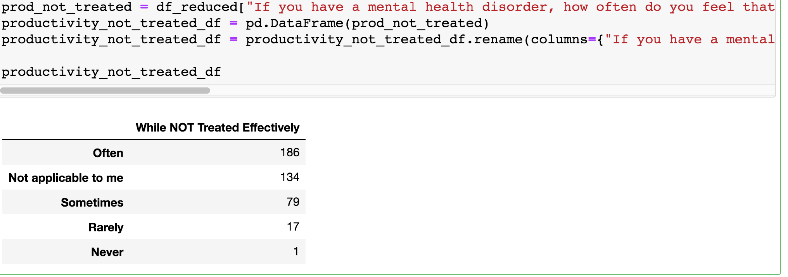
The effect of mental disorders on Productivity

Slide 12
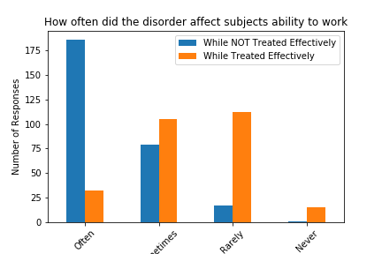

Slide 13
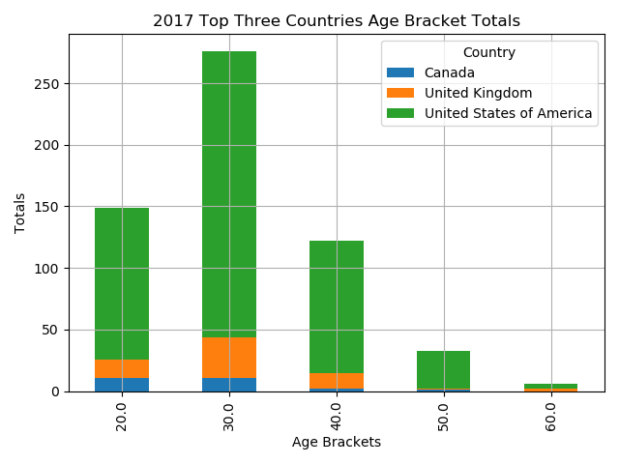
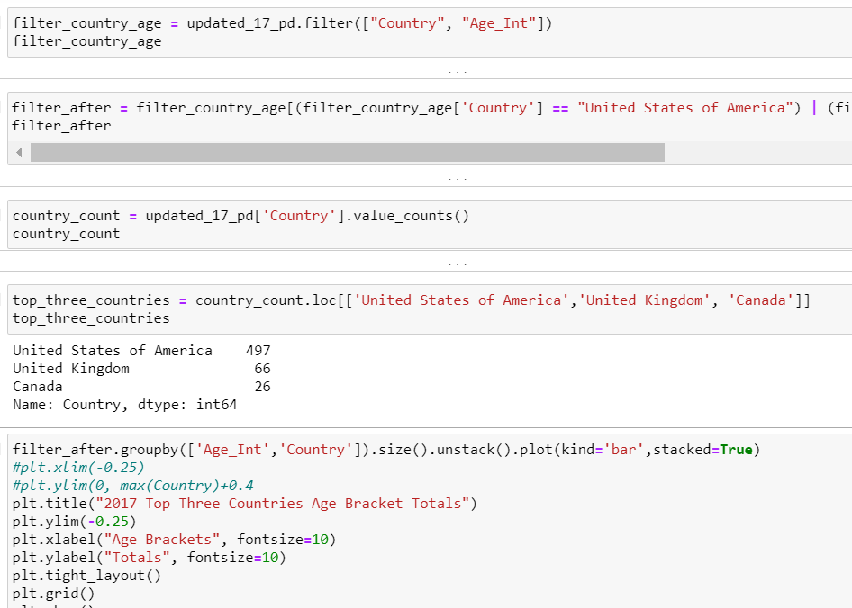

Slide 14
Has the perception of mental health changed in the workplace?

Slide 15
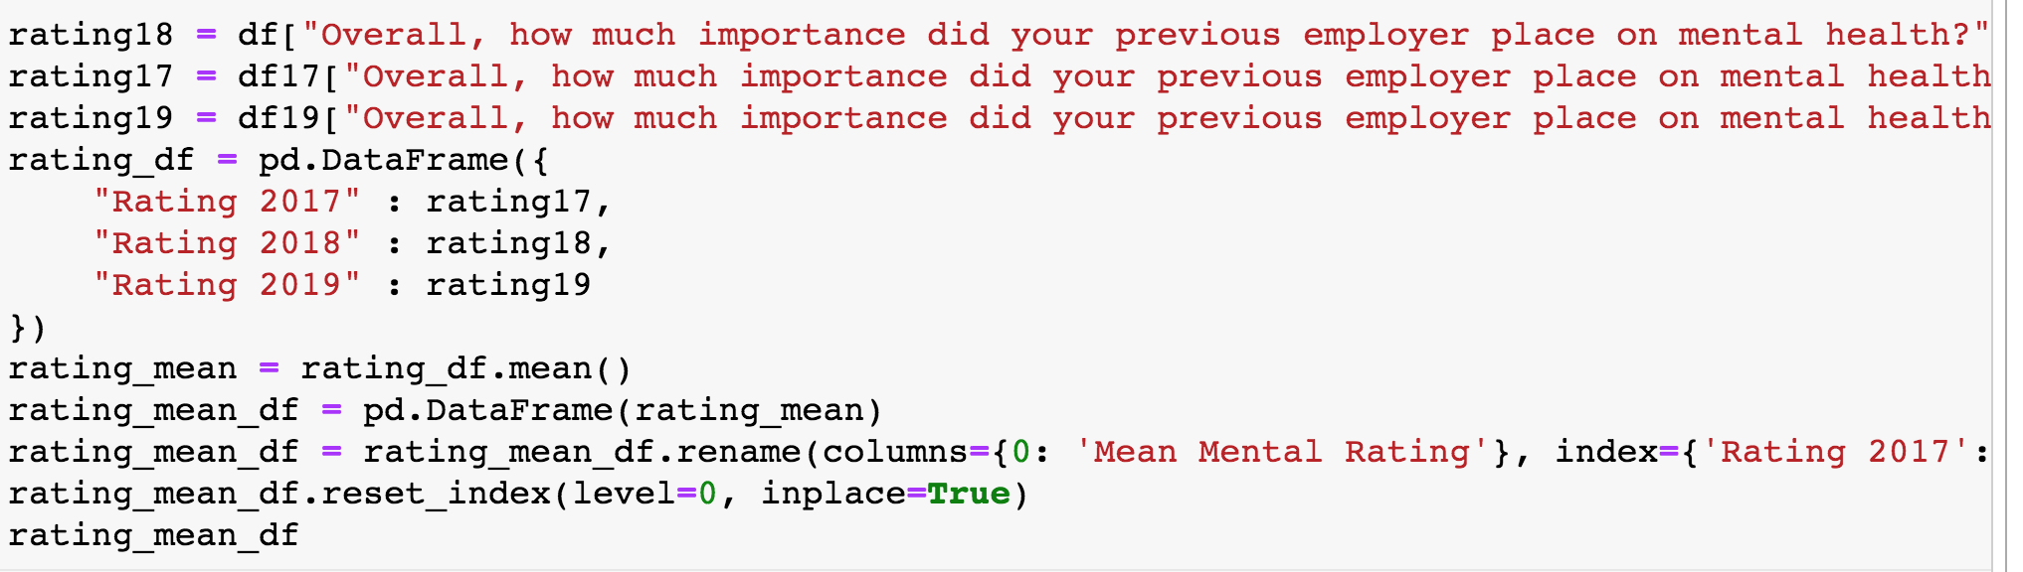
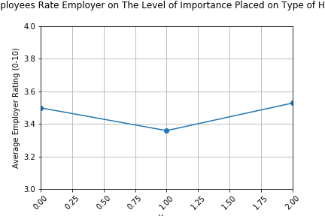
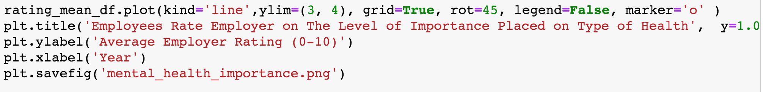
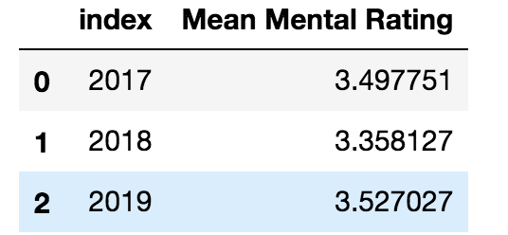
How much importance did your previous employer place on mental health?

Slide 16
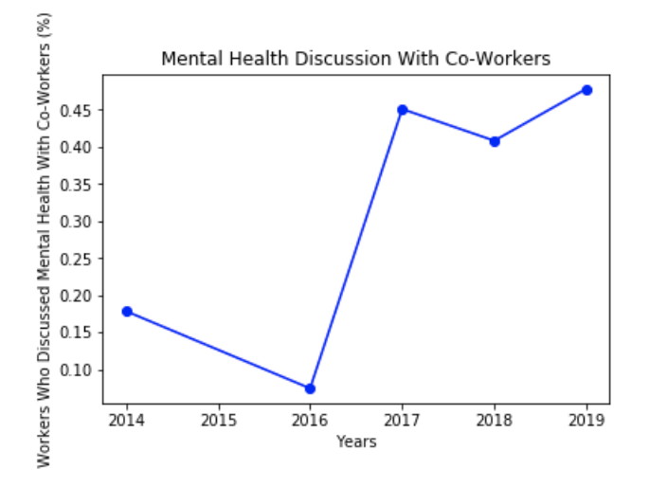
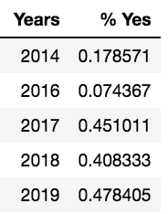
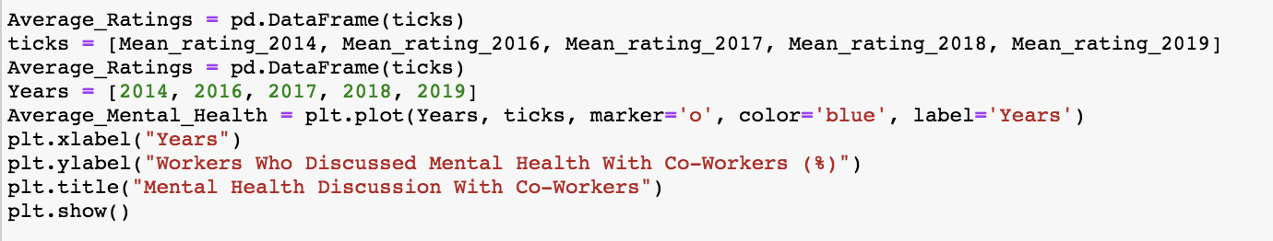
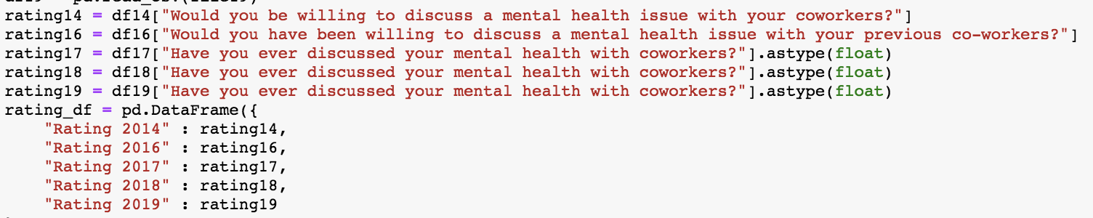
Have you ever discussed your mental health with your co-workers?

Slide 17
How does the perception of mental health compare to that of physical health in the workplace?

Slide 18
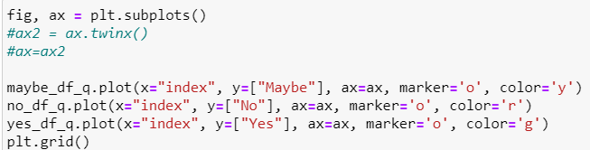

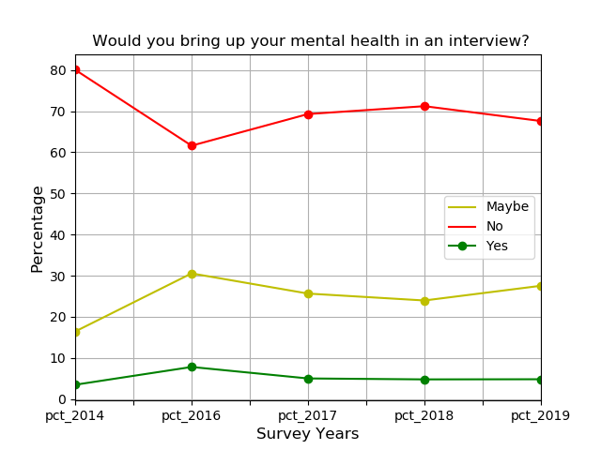
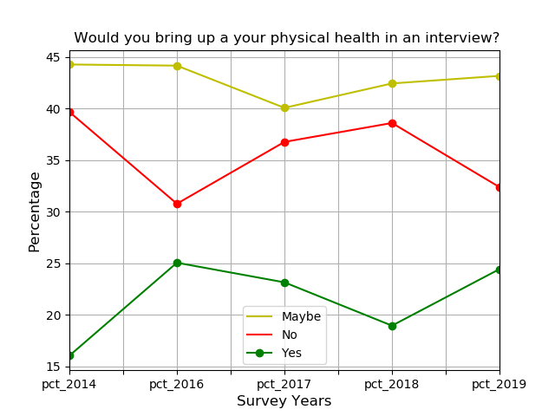
Bring up your mental health vs Physical health in an interview?

Slide 19
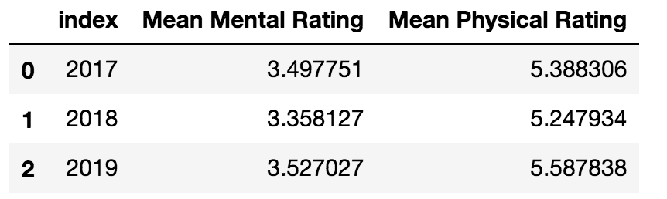
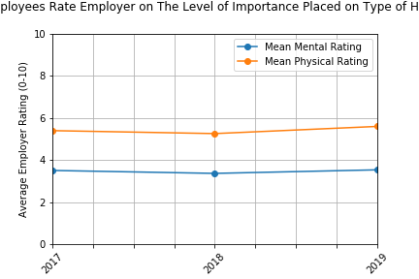
How much importance did your previous employer place on mental vs physical health?

Slide 20
Has the awareness of mental health changed over time?

Slide 21
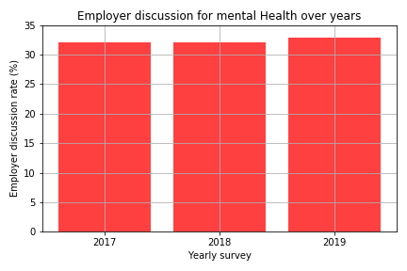
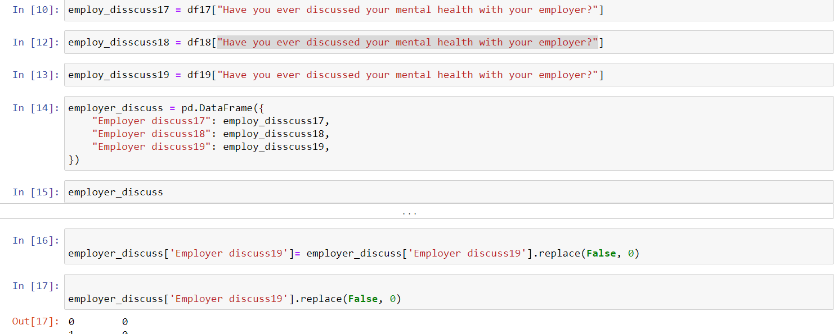
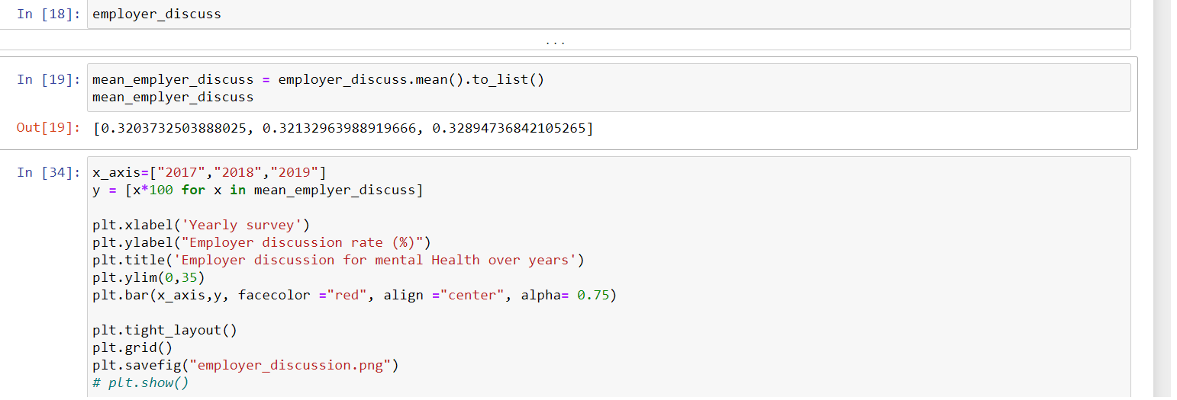
Employer discussion for mental Health

Slide 22
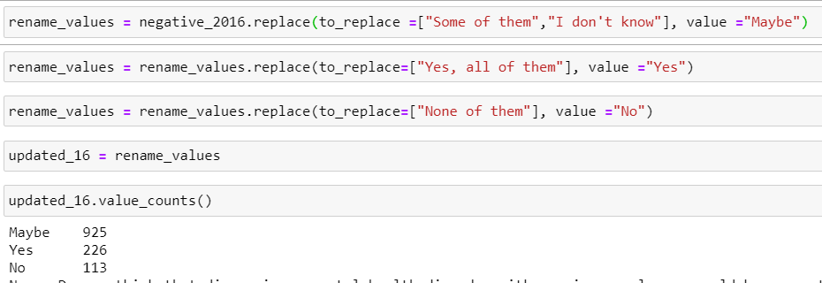


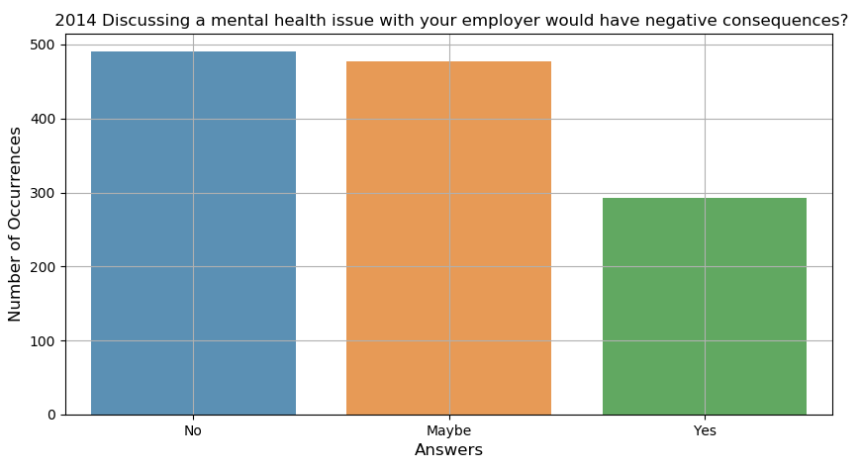
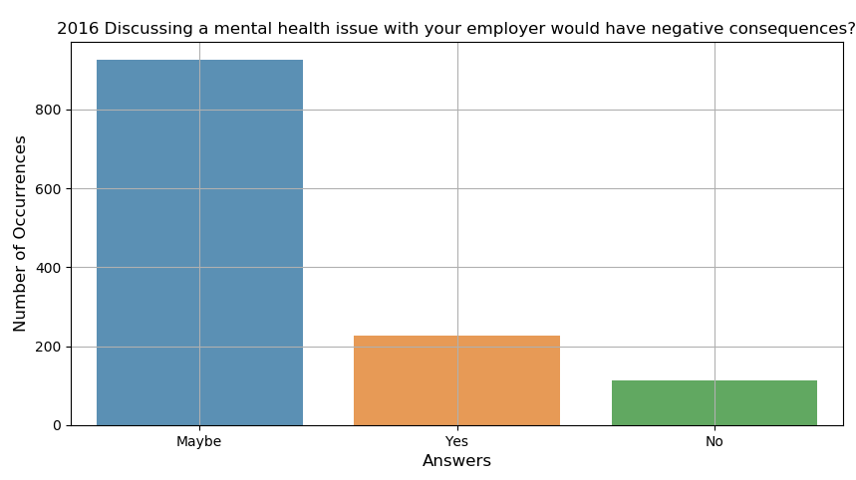
Discussing a mental health issue with employer would have negative consequences?

Slide 23
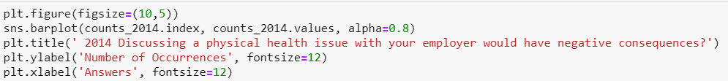
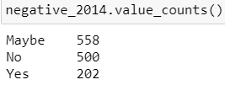
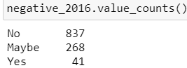
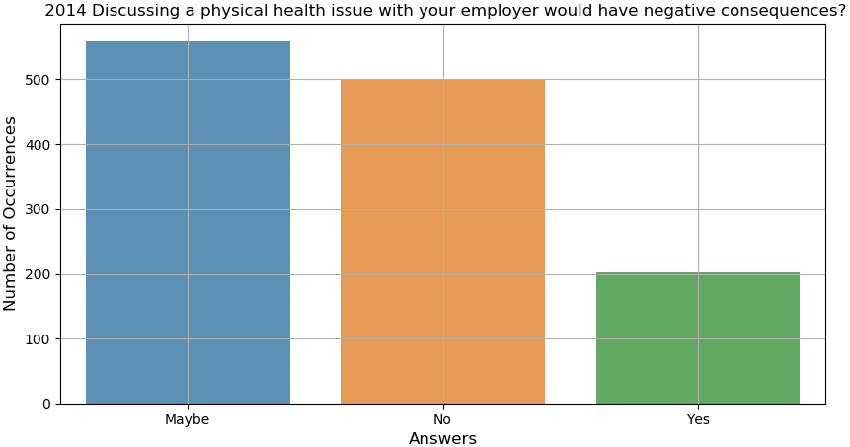
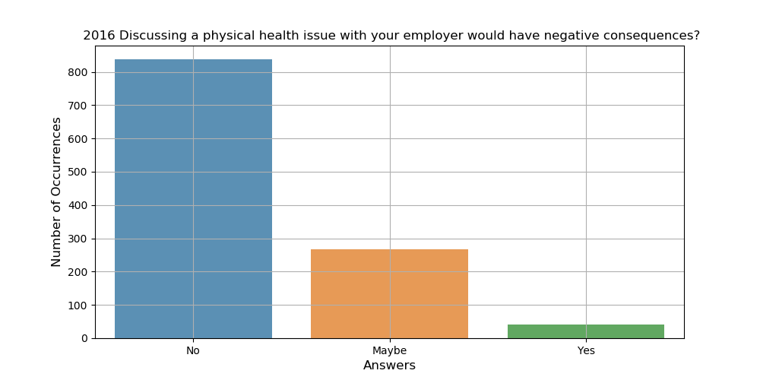
Discussing a physical health issue with employer would have negative consequences?

Slide 24
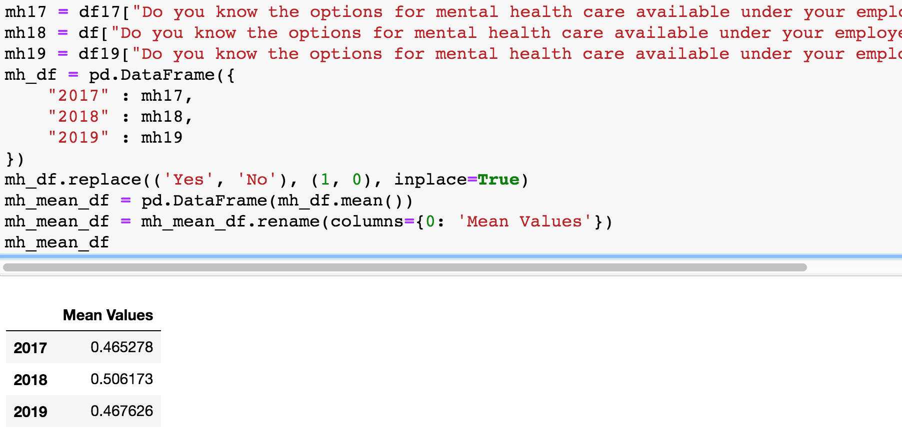
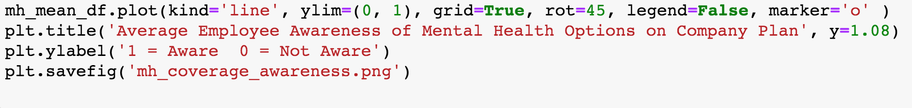
Average Employee Awareness of Mental Health options on Employer’s plan

Slide 25
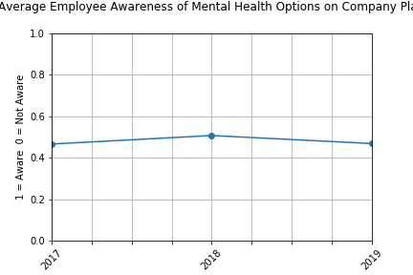

Slide 26
Summary
By plotting the top 5 surveyed countries, United States of America and United Kingdom remain the top 2. Then the order of Canada, Germany, Netherlands, Ireland, Brazil, Portugal during different years have changed slightly.
Mood disorder (depression, bipolar) are the most common type of metal health issue.
The male participant count is much higher than female participant count (73.3 % vs 23.6% in 2016).
Middle to big company have more counts to take the survey.
The effect of mental disorder to work productivity is huge between the treated and non-treated group.
From scale 1-10, the score of the employer place the importance on mental health is around 3.3~3.5, on the contrary, the score of the employer place the importance on physical health is around 5.3~5.6. (p value =0.000425).
The employer discussion rate has slightly improved with no significance (~32%-33%). The awareness of mental health care option remains 47%-50%.

Slide 27
We need to increase the perception and awareness of mental health and support those who are struggling!

